Slide 1
Analyzing Jumping Ability
Arnav Karnati

Slide 2
Project Goals
Analyze
Physical traits
Jump style
Footwear
Vertical by sport
Predict correlations using regression models

Slide 3
Datasets Used
NBA Combine
NFL Combine
Young Athletes
Data from the NBA pre-draft performances
Data from the NBA pre-draft performances
Countermovement Jump, Squat Jump, Reactive Strength Index, Speed data
Footwear vs. Jump
Dataset of people jumping with different footwear

Slide 4
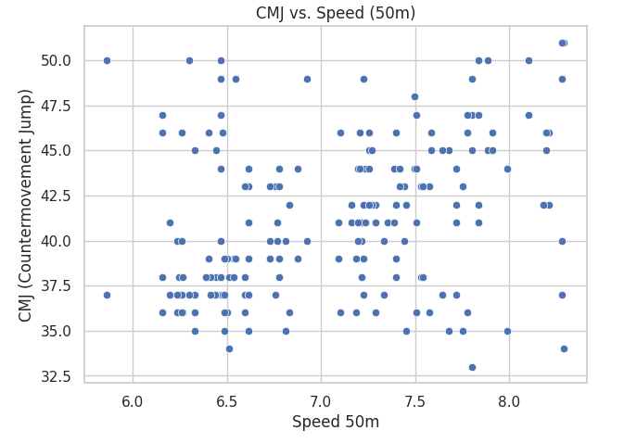
Young Athletes Correlation 1
Countermovement Jump (CMJ) vs. Speed (50m)
Positive correlation
Notes:
Countermovement Jump (CMJ) vs. Speed (50m) There is a moderate positive correlation between CMJ and 50m sprint speed.
Athletes who achieve higher verticals using countermovement (i.e., better use of elastic energy) also tend to have faster sprint speeds.
This suggests that explosiveness and elastic strength contribute significantly to sprint performance.

Slide 5
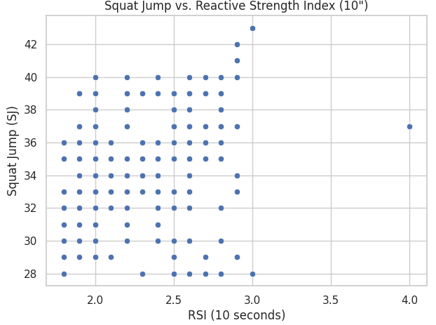
Young Athletes Correlation 2
Squat Jump (SJ) vs. Reactive Strength Index (RSI)
Athletes with higher RSI values tend to have better SJ scores, even though SJ removes the countermovement
Notes:
Squat Jump (SJ) vs. Reactive Strength Index (RSI) Athletes with higher RSI values tend to have better SJ scores, even though SJ removes the countermovement.
This suggests that reactive strength (plyometric ability) benefits both static and dynamic jump scenarios.
RSI is a good proxy for lower-body neuromuscular explosiveness.

Slide 6
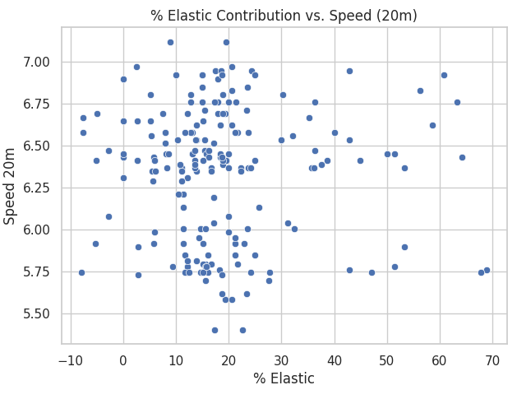
Young Athletes Correlation 3
Notes:
% Elastic vs. Speed (20m) Athletes with a higher percentage of elastic contribution (i.e., CMJ - SJ difference) generally perform better over 20m.
This reinforces that elastic energy utilization is crucial for quick accelerations.

Slide 7
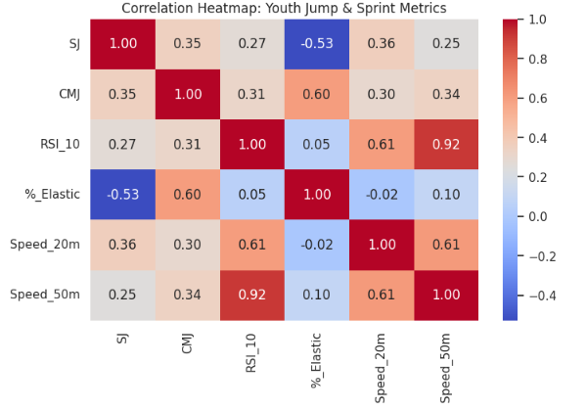
Young Athletes Heat Map
Notes:
CMJ ↔ Speed 50m → More explosive athletes sprint faster.
RSI ↔ SJ → Indicates shared reliance on rapid force production.
Weak/No correlation:
% Elastic ↔ SJ – Elastic contribution doesn’t influence static jumping.
Average height (if it's jump height) doesn’t strongly correlate with sprint metrics.

Slide 8
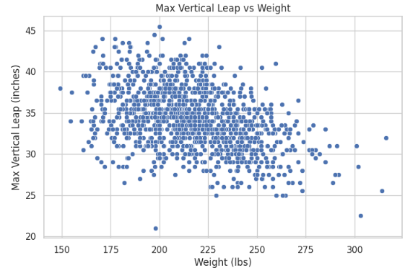
NBA Combine Visualization 1
Weight vs Jump
Notes:
As expected lighter players jump slightly higher

Slide 9
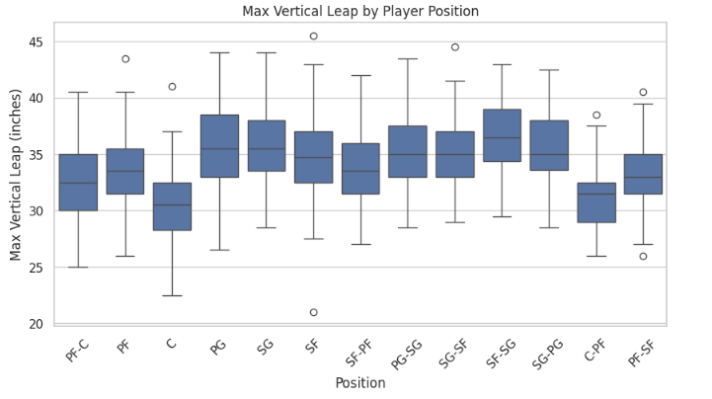
NBA Combine Visualization 2
Notes:
Standing reach has almost no correlation with vertical leap — vertical jump is more about explosiveness than static limb length.
- Positionally, guards (PG/SG) tend to have higher verticals than big men (C/PF).
- Use of proper training (strength + plyometrics) is likely a more significant factor than just physical build.

Slide 10
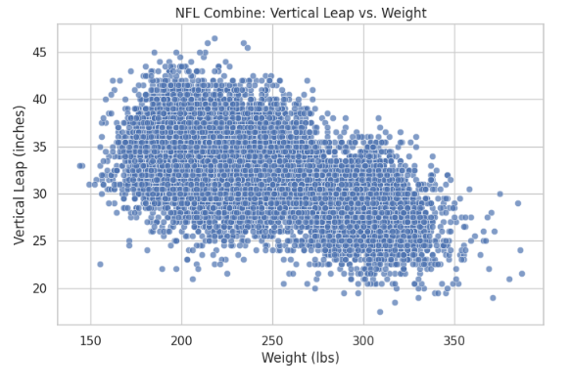
NFL Combine Visualization 1
Weight vs Jump
Notes:
Due to greater disparities in weight in the NFL, stronger negative correlation between weight and jump

Slide 11
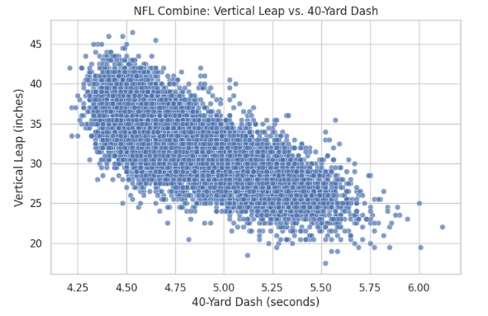
NFL Combine Visualization 2
Dash vs Jump
Notes:
More explosive, more height

Slide 12
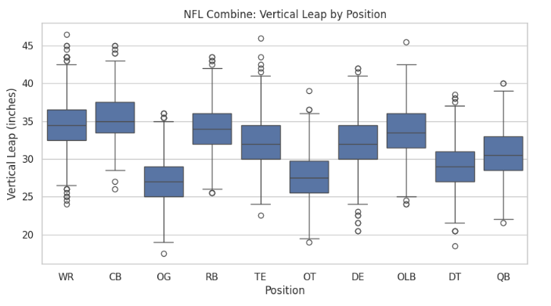
NFL Combine Visualization 3
Notes:
More support for more explosive, more height
Vertical leap is not just about size—it’s about explosiveness, and both sports develop it differently.

Slide 13
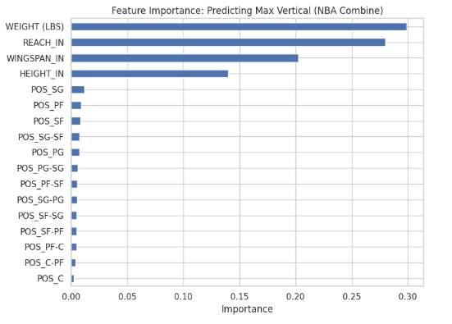
Predictive Model 1
Notes:
A linear relationship exists between physical traits and vertical jump — but it’s not the whole story. A purely non-linear model (like Random Forest) didn’t outperform it, suggesting jump height depends linearly on key variables, but other unexplored factors may matter too (e.g., training type, fast-twitch fiber %).
Conclusion:
Explosiveness (vertical leap) is more influenced by body mechanics than role/position.
Players with longer arms and higher reach tend to record higher verticals — likely because they generate more upward force from advantageous limb lengths.
Position doesn’t matter as much once height and reach are accounted for.
Final Takeaways for the NBA Model: You can make a fairly accurate estimate of someone’s max vertical jump using just:
Weight, Reach, Wingspan
This model could be used to:
Predict athleticism potential for draft prospects, Flag underperformers (e.g., someone with great reach but poor vertical)

Slide 14
How it works
Model Type: Linear Regression + Random Forest Regressor
Target: MAX VERTICAL LEAP (INCHES)
Takes physical measurements of athletes (e.g., weight, wingspan, height).
Uses those values to estimate how high an athlete can jump.
Linear Regression fits a line through the data, assuming a straight-line relationship.
Random Forest tries to capture more complex patterns using many decision trees.
Notes:
Model Type: Linear Regression + Random Forest Regressor
Target: MAX VERTICAL LEAP (INCHES)
🔧 How It Works:
Takes physical measurements of athletes (e.g., weight, wingspan, height).
Uses those values to estimate how high an athlete can jump.
Linear Regression fits a line through the data, assuming a straight-line relationship.
Random Forest tries to capture more complex patterns using many decision trees.
Each model "learns" from the data by minimizing prediction error (difference between predicted and actual jump heights).
🔍 Why It’s Useful:
Helps identify what body features most affect vertical leap.
Useful for talent scouting, training focus, or evaluating potential.

Slide 15
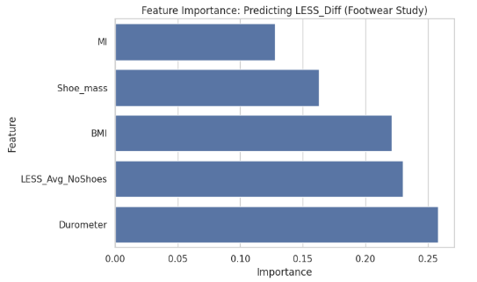
Predictive Model 2
Notes:
Footwear Dataset
Sole hardness (durometer) and baseline movement quality (LESS_Avg_NoShoes) are strongest indicators of how much a shoe will affect landing mechanics.
Surprisingly, Shoe_mass had less impact than expected — suggesting shoe stiffness matters more than shoe weight in this group.
Participants who perform poorly barefoot tend to show greater change with shoes — highlighting the value of baseline movement screening.
Why the Model Performed Poorly (and that’s okay!) 🔹 Sample size may be small — hard for Random Forest to generalize
🔹 LESS_Diff might be influenced by unmeasured factors: fatigue, test error, footwear type (cleats, cross-trainers, etc.)
🔹 Interaction effects (e.g. high BMI + high durometer) might require more complex models (e.g., SHAP, boosted trees)
While the model can’t predict LESS_Diff reliably, it still offers insight:
Shoe stiffness and baseline movement quality are key factors in whether an athlete's landing form changes with shoes.

Slide 16
How it works
Model Type: Random Forest Regressor
Target: LESS_Diff (difference in landing form with shoes vs. barefoot)
Inputs include shoe characteristics (e.g., shoe mass, durometer) and body metrics (BMI, MI).
The model tries to predict how much an athlete's landing form changes when wearing shoes.
Random Forest combines multiple decision trees to capture patterns between footwear/body and LESS score change.
It "learns" which features most impact how footwear alters movement.
Helps identify which athletes are most sensitive to shoe changes.
Notes:
Model Type: Random Forest Regressor
Target: LESS_Diff (difference in landing form with shoes vs. barefoot)
🔧 How It Works:
Inputs include shoe characteristics (e.g., shoe mass, durometer) and body metrics (BMI, MI).
The model tries to predict how much an athlete's landing form changes when wearing shoes.
Random Forest combines multiple decision trees to capture patterns between footwear/body and LESS score change.
It "learns" which features most impact how footwear alters movement.
🔍 Why It’s Useful:
Helps identify which athletes are most sensitive to shoe changes.
Can guide shoe selection, custom footwear, or movement screening

Slide 17
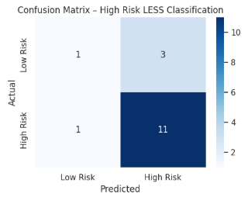
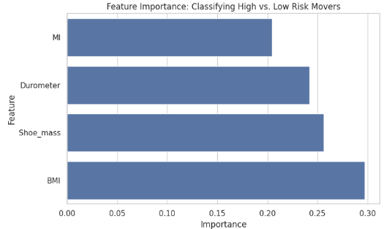
Predictive Model 3
Injury Risk
Notes:
Suggests that lighter shoes with lower durometer, and targeted interventions for higher BMI athletes, may reduce LESS risk scores.
Practical screening tool for coaches and clinicians.
Combine this with subjective movement assessments or motion capture for better precision.
Could be improved with more balanced data or additional features (e.g., strength, fatigue, jump history).
True Positives (11): Correctly predicted high-risk movers
True Negatives (1): Correctly predicted low-risk movers
False Positives (3): Low-risk athletes wrongly flagged as high-risk
False Negatives (1): High-risk athlete missed by the model

Slide 18
Importance of Factors
FEATURE | Importance | Interpretation
BMI | Highest | Positive correlation with Risk
Shoe Mass | High | Heavy shoes = worse landing
Durometer | Medium | Stiff Soles = higher risk
Movement Index | Lower | Low correlation??
Notes:
Predict whether an athlete is high-risk (LESS score ≥ 6) or low-risk (LESS score < 6) based on:
BMI
Shoe_mass
Durometer (sole stiffness)
MI (Movement Index)
Random Forest Classifier
A Random Forest builds many decision trees and aggregates their predictions (like a majority vote).
Each tree is trained on a random subset of data and features.
The goal is to classify each athlete into either:
High Risk (1) — landing form suggests injury risk
Low Risk (0) — safer landing mechanics
This model is ideal for athlete screening, especially in:
Pre-season evaluations
Return-to-play decisions
Custom shoe design/testing
While it’s overcautious, it reliably flags those at risk — making it valuable in injury prevention protocols.

Slide 19

Thank you!
Do you have any questions?

Slide 20
Resources
https://github.com/josedv82/public_sport_science_datasets
https://data.mendeley.com/datasets/z727frmfdw/1
https://ijspt.scholasticahq.com/article/81107-effect-of-footwear-versus-barefoot-on-double-leg-jump-landing-and-jump-height-measures-a-randomized-cross-over-study

